Slide 1


Savitribai Phule Pune University, Pune Amrutvahini College Of Engineering, Sangamner Department of E&TC Engineering A Presentation on
“Voice operated lift control system with safety”
Presented By
1.Bhoknal Gayatri Satish(Roll no.07) 2.Varpe Aditya Rajendra(Roll no.66) 3.Waman Onkar Uttam (Roll no.69) 4.Zanjare Shaileshumar Gangaram(Roll no.72)
Under the Guidance of
Prof. V. R. Aware

Slide 2
Contents
Introduction
Need of project
Research motivation
Aim and objective of project
Literature Survey
Problem Statement (Title of Project)
Block Diagram of Project
Explanation of Block Diagram
Flow chart
Conclusion
References

Slide 3
Introduction
Physically challenged people face many problems every day. One of these challenges is the use of elevators in many buildings. They should be able to enjoy using the elevator easily.
To overcome this challenge for the them, we must focus on the following issues: Make sure the person is at the elevator door, get elevator there and ask person where to go and accordingly go to respective floor.
Speech is the superior personality of the human beings gifted by the nature. Speech helps to deliver the thoughts and messages between human. Speech recognition is the process of the computer recognizing human speech to generate a string of words or commands. Sometimes it is known as automatic speech recognition.
Speech recognition is becoming more perplexing and difficult task. The speech recognition research is focuses mainly on large vocabulary, continuous speech capabilities and speaker independence[3].
A voice-operated elevator system is proposed where the user’s input commands to control the movement of the elevator system are kept convenient for the users. The commands include voice input for the floor operations, directions, elevator car’s door operation, and a special command to call for emergency[4].

Slide 4
Need Of Project
The visually challenged people cannot use the elevator easily. It is difficult to use the keypad if they cannot see it. Sometimes the keypad has Braille technique, but they will have hard time for locating its place. Even though they found the keypad, how can they know the number if they do not know Braille?
They always need help in elevators from someone to press the button for them and to tell them when the elevator cabin arrives. In case of emergency how they will act if there is no one with them to help . So voice-controlled elevator can be a very good option for this people.
One more drawback of the current lift is that it cannot tell on which floor the lift is stuck, nor the parameters like temperature of motor, fire detection inside the lift. But by using this voice operated lift we can solve all these problems.

Slide 5
Research Motivation
Elevators are an integral part of modern urban infrastructure, providing vertical transportation for millions of people daily. While elevator technology has advanced significantly over the years, there are still areas that require improvement, particularly in terms of user convenience and safety.
As most of the physically challenged people find it difficult to operate the elevator. Also modern elevators lacks features such as voice recognition and also its connectivity with the internet for real-time parameters and controlling the elevator.
So we’ve found a solution on this, integrating voice recognition capabilities with the lift(elevator) for conveniently operate elevator with just some voice commands and also get feedback in audio format from the lift control system.
Also send all this info in real-time to the web server for accessing it over internet.

Slide 6
Aim of the Project:
Design and development of a voice-controlled lift/elevator control system with enhanced security features for human-machine communication.
Objectives of the Project:
1. To operate lift through voice commands with easy use for people with visual and
physical challenges.
2. To measure parameters like floor number, weight of the lift, fire detection,
temperature of motor, etc.
3. To give real time information of lift parameters on the webpage and sending
emergency alert on respective webpage.

Slide 7
Literature survey
SR.NO. | Title Of Research Paper | Author Name | Published Year | Proposed System
1 | Elevator Control Using Speech Recognition for People with Physical Disabilities[4] | Komal Mahajan, Riddhi Nahar, Dhanali Khairnar, Shrutika Kinge, Sujata Suryawanshi | 2021 | The research combines speech recognition technology with machine learning to make the elevator control equipment that can be controlled by voice. This system uses python based machine learning libraries with Raspberry pi 3B+. The word can be trained for more than hundreds of words.

Slide 8
SR.NO. | Title Of Research Paper | Author Name | Published Year | Proposed System
2. | Voice Operated Intelligent Lift[5] | Rashmi P C, Amulya, A Karthik Shetty, Akshata, Dilip Kumar U K | 2019 | In this system the lift operates based on the input voice commands. In this project MATLAB coding is used for voice recognition and IR sensor is used for detecting the floors and stopping the motor rotation. The DC motor is used for controlling the lift. The microcontroller is programmed using Embedded C.
3. | Voice Based Lift Control[6] | Malim Huzaifa Salim, Sami Jaitapkar, Faki Ziyaan, Kazi Ibrahim | 2022 | This system accepts input by microphone, and taking the elevator to the destination accordingly. It uses raspberry pi and a speech API to communicate with cloud for the voice recognition.

Slide 9
4. | Implementation of Voice based Touchless Lift System[9] | B. Swathi, Akshay S Prathap, Aiswarya V Kumar, Ranjitha R, Raviteja Kaki | 2021 | This system uses Arduino Mega and Elechouse V3 Voice Recognition Module to correctly detect the command given by user, and uses servo motor to lift up and down the elevator, and a servo motor to open and close the doors of the elevator. For all this motors, it uses a relay driver circuit for driving the motors.

Slide 10
Problem Statement
“To design and develop a voice-controlled lift/elevator control system with enhanced security features for human-machine communication”

Slide 11
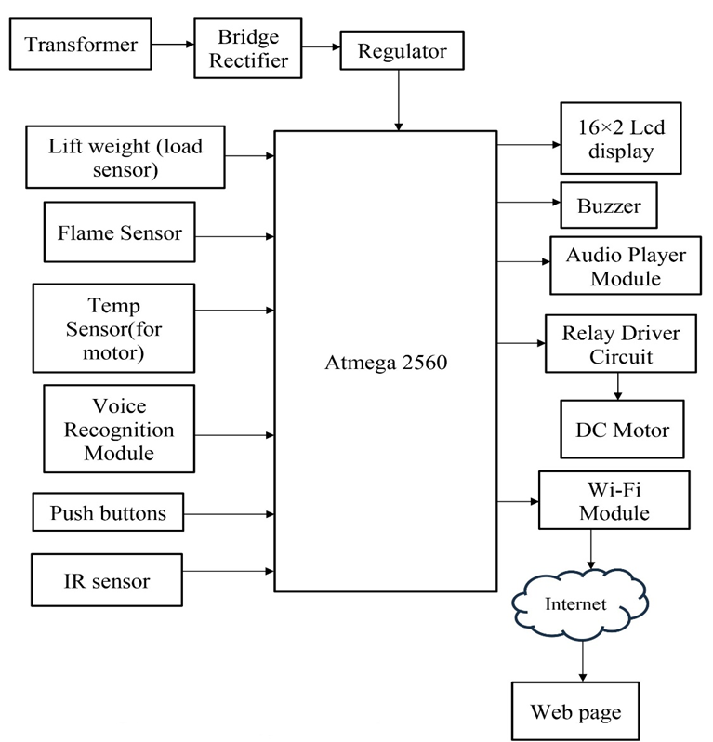
Block Diagram

Slide 12
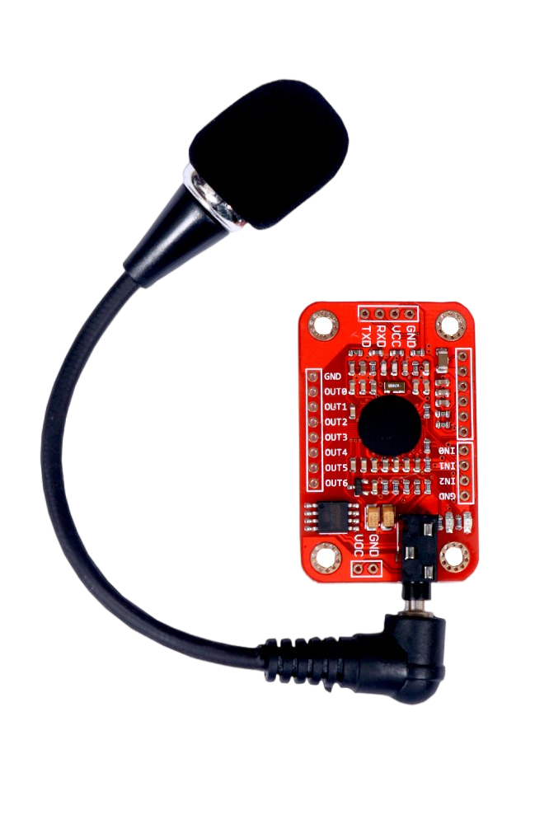
Explanation of Block Diagram
Transformer: Steps down the AC mains voltage to a suitable level for the rest of the system.
Bridge rectifier: Converts the AC voltage from the transformer to DC.
Regulator: Provides a stable DC voltage to the system, even if the mains voltage fluctuates.
Voice recognition module:
Converts the user's spoken commands into an command number which is already stored in module. Voice Recognition Module product is a speaker-dependent voice recognition module. It supports up to 80 voice commands in all. Max 7 voice commands could work at the same time. Any sound could be trained as the command. Users need to train the module first before let it recognizing any voice command.

Slide 13
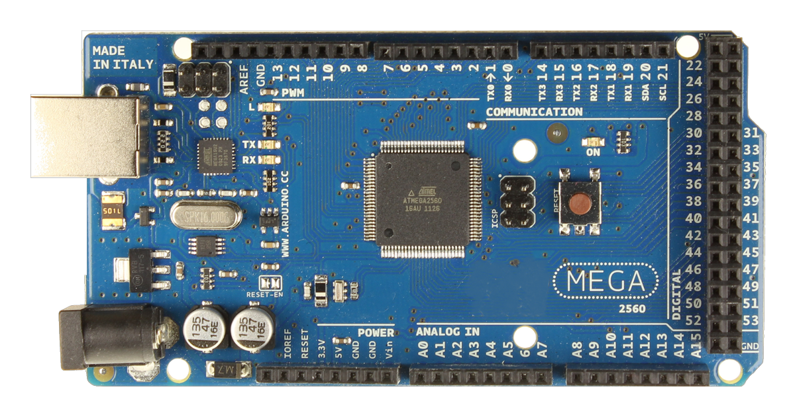
Atmega 2560 microcontroller[10]:
The brain of the system, which controls all of the other components. The ATmega2560 is an 8-bit, low-power microcontroller that is based on the AVR-RISC architecture. It's commonly found in the Arduino Mega 2560 development board.
The ATmega2560 has the following features:
16MHz clock frequency
8KB SRAM
4KB EEPROM
256KB of programmable flash memory
Executes powerful instructions in a single clock cycle
Temperature range of 40°C to 85°C
Ultra-low power consumption

Slide 14
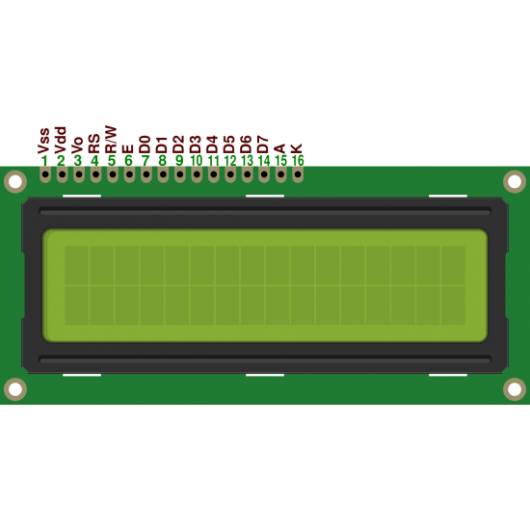
16x2 LCD display:
Displays the current floor number and other system information. A 16x2 LCD display can display 16 characters on 2 lines. The characters are white on a blue background. The display has a 5x7 pixel matrix for each character.
Here are some specifications for a 16x2 LCD display:
Display capacity: 16 characters x 2 rows
Display color: Blue backlit
Character size: 2.95 mm wide x 4.35 mm high
Character pixels: 5 W x 7 H
Voltage requirements: 5 VDC +/- 0.5V
Current requirements: 2 mA @ 5 VDC

Slide 15
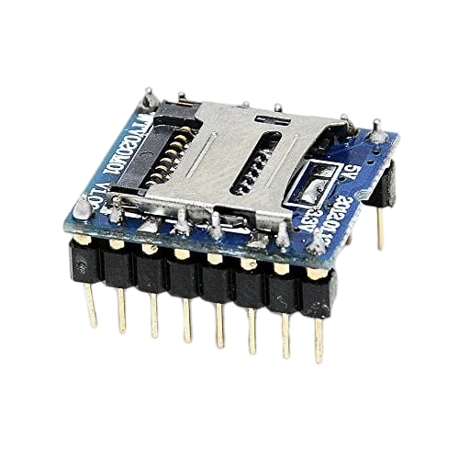
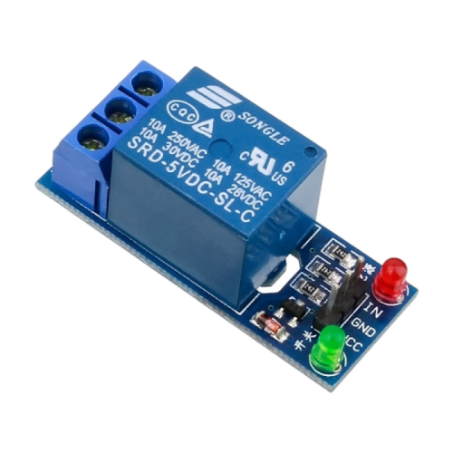
Buzzer: Provides audible feedback to the user.
Audio player module: Plays audio cues, such as "Going up" and "Arrived at your floor.“
This Module is a reusable mass storage voice module, that can plug a maximum capacity of 1GB SD card memory and can load the WAV and AD4 audio.
Supports the FAT file system SD carrier.
Supports the playing of 4Bit ADCPM format files.
Recognize the voice files automatically.
Support microprocessors and key control.
Relay circuit: Controls the DC motor.
Also speed of motor can be controlled by providing
appropriate signal at the “IN” pin

Slide 16
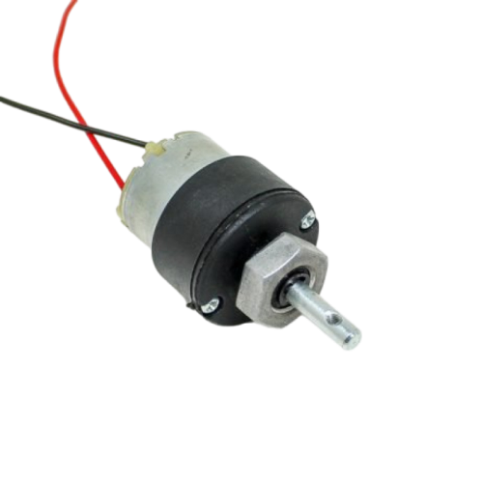
DC motor: Drives the lift car up and down the shaft.
This DC Motor 10RPM 12Volts can be used in all-terrain robots and a variety of robotic applications. These motors have a 3 mm threaded drill hole in the middle of the shaft thus making it simple to connect it to the wheels or any other mechanical assembly.
IR sensor: Detects the floor number from which lift has passed.
Lift weight (load sensor): Monitors the weight of the lift car and prevents it from being overloaded.
Flame sensor: Detects fires in the lift.
Temp sensor (for motor): Monitors the temperature of the lift motor and prevents it from overheating.

Slide 17
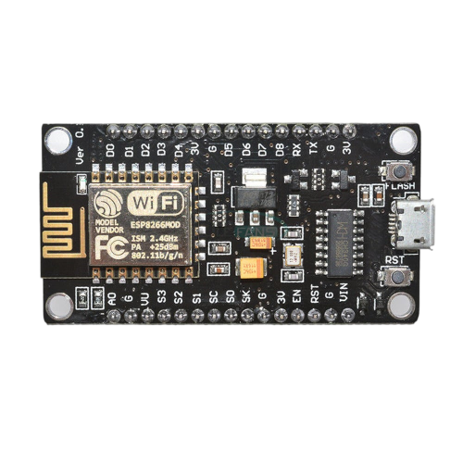
Wi-Fi module: Connects the system to the internet. The ESP8266 is a low-cost Wi-Fi chip that enables microcontrollers to connect to 2.4 GHz Wi-Fi. It's mostly used for developing IoT (Internet of Things) embedded applications.
Internet: Allows the system to be monitored and controlled remotely.
Web page: Provides a user interface for monitoring the system remotely

Slide 18
Hardware and Software Requirements
H/W requirements:
Atmega 2560 microcontroller
Regulator
Load sensor
Flame Sensor.
Temp sensor.
Voice recognition module.
Push buttons
16×2 Lcd display
Buzzer
Audio player module
Relay driver circuit
DC motor
Wi-Fi module ESP 8266
S/W requirements:
Arduino IDE
PCB wizard
Web page (using Html, CSS, JS)

Slide 19
Flow chart
Initialize the system
Lift arrives the floor where it detects human presence in front of lift door
Wait till passenger enters into lift with some delay
Voice recognition module listens command from passenger
Return command number to microcontroller
Microcontroller sends instruction to relay driver according to command number
Repeat till system is turned off
While current_floor_no != desired_floor_no
true
Rotate motor in respective direction
false
Stop the motor
Play audio as “reached at floor x”
Wait till passenger leaves lift
Send all parameters to web server

Slide 20
Detailed Algorithm
Initialize the system.
Lift arrives the floor where it detects human presence in front of lift door.
User enters into lift.
Listen for a voice command from the user.
Compare the voice command with already stored commands and return command number using the voice recognition module.
Microcontroller determines which floor the user wants to go to based on the command value returned by voice recognition module.
Send a signal to the relay driver circuit to activate the DC motor in the desired direction.
Monitor the current floor number using the IR sensor.
When the lift car reaches the desired floor, send a signal to the relay driver circuit to deactivate the DC motor.
Play an audio cue to inform the user that they have arrived at their destination.
While all this is working, the floor number, motor temperature, flame sensor, and load sensor parameters are send to web server in real-time for monitoring purpose.
Repeat steps 2-8 until the system is shut down.

Slide 21
Conclusion
Voice-controlled elevators are a long-term solution that can be used by anyone, including people with disabilities. They have the potential to make life easier for everyone and reduce the spread of germs.
In addition to the benefits mentioned above, voice-controlled elevators could also be used to improve security and convenience. For example, authentication could be used to restrict access to certain floors, and sensors could be used to reduce the need for users to give specific commands.
Voice-controlled elevators have a wide range of potential applications, including in homes, offices, hospitals, hostels, and public places.
Overall, voice-controlled elevators are a promising technology with the potential to improve our lives in many ways.

Slide 22
References
Dilip Mathuria, Aditya Gaur, Ashish Gupta, “FPGA Implementation of Biometric based Elevator Controller”, IJETSR Volume 5, Issue 3, March 2018
Farouk Salah Mohamed Saod, Dr Maher Abdel Aziz, “Elevator for blind people using voice recognition” International Journal of Scientific & Engineering Research vol 9 Issue 7,July 18
Kaladharan N, Assistant Professor ,Dept. of Electrical Engineering. Annamalai University, IJIRCCE, “A study of speech recognition” volume.3,issue 9,page 8030- 8034,September 2015.
Komal Mahajan, Riddhi Nahar, Dhanali Khairnar, Shrutika Kinge, Sujata Suryawanshi, “Elevator Control Using Speech Recognition for People with Physical Disabilities” IJARIIE Vol-7 Issue-3 2021
Rashmi P C, Amulya, A Karthik Shetty, “Voice Operated Intelligent Lift” JETIR February 2019, Volume 6, Issue 2
Malim Huzaifa Salim, Sami Jaitapkar, Faki Ziyaan, Kazi Ibrahim, “Voice Based Lift Control” IJRASET Volume 10 Issue V May 2022

Slide 23
P.Cernys, V.Kubilius, V.Macerauskas, K.Ratkevicius, “Intelligent Control of the Lift Model” IEEE international Workshop on Intelligent Data Acquisition and Advanced Computing System: Technology and Applications 8-10 September 2003
Aishwarya Pokharkar, Niriksha Poojari, Harish Pawar , Amey Patil, “Voice Operated Elevator” IJISRT Volume 6, Issue 5, May – 2021
B. Swathi, Akshay S Prathap, Aiswarya V Kumar, Ranjitha R, Raviteja Kaki, “Implementation of Voice based Touchless Lift System” IJSRCSEIT Volume 7, Issue 4, July-August-2021
Datasheet of Atmega 2560 microcontroller.

Slide 24
Thank You!!!

